Slide 1

NODE JS
Aruna S
Department of
Computer Science and Engineering

Slide 2

NODE JS
Module System
S. Aruna
Department of Computer Science and Engineering

Slide 3
NODE JS
Node JS Modules
https://nodejs.org/dist/latest-v12.x/docs/api/
To see all the available modules
Few modules are inbuilt globally available.
Ex: Console module, Timer Module
Many modules need to be explicitly included in our application
Ex: File System module
Such modules need to be required at first in the application

Slide 4
NODE JS
Node JS Timer Module
This module provides a way for functions to be called later at a given time.
The Timer object is a global object in Node.js, and it is not necessary to import it
Method | Description
clearImmediate() | Cancels an Immediate object
clearInterval() | Cancels an Interval object
clearTimeout() | Cancels a Timeout object
ref() | Makes the Timeout object active. Will only have an effect if the Timeout.unref() method has been called to make the Timeout object inactive.
setImmediate() | Executes a given function immediately.
setInterval() | Executes a given function at every given milliseconds
setTimeout() | Executes a given function after a given time (in milliseconds)
unref() | Stops the Timeout object from remaining active

Slide 5
NODE JS
NPM and installing modules
NPM is a package manager for Node.js packages, or modules if you like.
www.npmjs.com hosts thousands of free packages to download and use.
The NPM program is installed on your computer when you install Node.js
A package in Node.js contains all the files you need for a module.
Modules are JavaScript libraries you can include in your project.
Example:
validator package is downloaded and installed. NPM creates a folder named "node_modules", where the package will be placed.
To include a module, use the require() function with the name of the module

Slide 6
NODE JS
Importing your own modules
The module.exports is a special object which is included in every JavaScript file in the Node.js application by default.
The module is a variable that represents the current module, and exports is an object that will be exposed as a module.
So, whatever you assign to module.exports will be exposed as a module. It can be
Export Literals
Export Objects
Export Functions
Export Function as a class

Slide 7
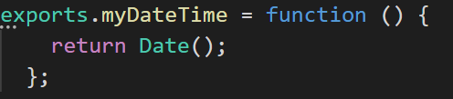


NODE JS
Importing your own modules
You can create your own modules, and easily include them in your applications.
The following example creates a module that returns a date and time object:
Use the exports keyword to make properties and methods available outside the module file.

Slide 8
NODE JS
Package.json file
All npm packages contain a file, usually in the project root, called package.json
This file holds various metadata relevant to the project.
It is used to give information to npm that allows it to identify the project as well as handle the project's dependencies.
It can also contain other metadata such as a project description, the version of the project in a particular distribution, license information, even configuration data - all of which can be vital to both npm and to the end users of the package.
The package.json file is normally located at the root directory of a Node.js project.

Slide 9
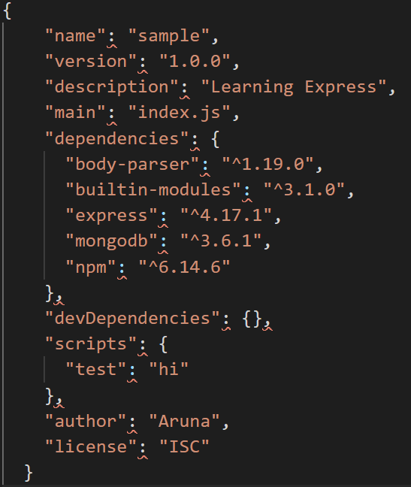
NODE JS
A Sample Package.json file

Slide 10
NODE JS
CHALK and nodemon Module
https://www.npmjs.com/package/chalk
The Chalk Module Can Be Used With The Console's String Interpolation in Node. Js.
The Chalk module allows you to add styles to your terminal output.
https://www.npmjs.com/package/nodemon
Nodemon is a utility that will monitor for any changes in your source and automatically restart your server.
Just use nodemon instead of node to run your code

Slide 11
THANK YOU
Aruna S
Department of
Computer Science and Engineering
arunas@pes.edu

